Slide 1


Slide 2
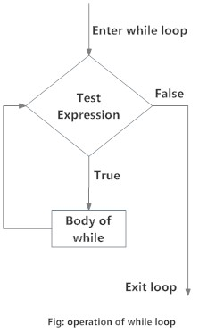
While loop
Using while loops we can execute a set of
statements as long as a condition is true.
The format of a while loop is shown below:
while <expr>:
<statement(s)>
<statement(s)> represents the block
to be repeatedly executed, often
referred to as the body of the loop.
This is denoted with indentation,
just as in an if statement.

Slide 3
Consider this loop:
n = 5
while n > 0:
n -= 1
print(n)
..............................................
Output:
4
3
2
1
0

Slide 4
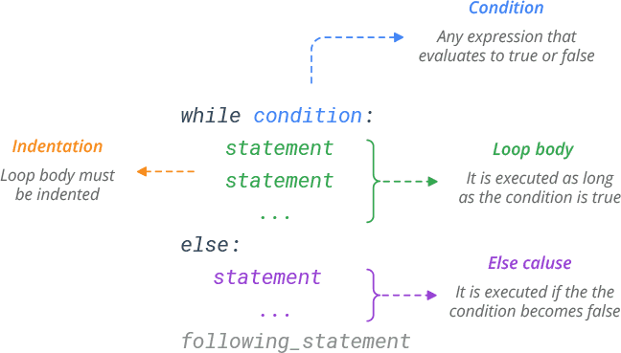
The else Clause
Python allows an optional else clause at
the end of a while loop. This is a unique
feature of Python , not found in most
other programming languages.
The syntax is shown below:
while <expr>:
<statement(s)>
else:
<additional_statement(s)>
The <additional_statement(s)> specified in the else clause will be executed when the while
loop terminates.
Hence, a while loop's else part runs if no break occurs and the condition is false.
4

Slide 5
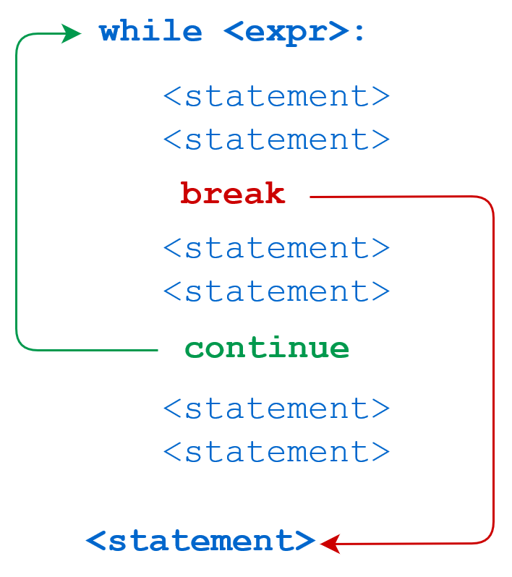
Python break and continue Statements
The Python break statement immediately terminates a loop entirely. Program execution proceeds to the first statement following the loop body.
The Python continue statement immediately terminates the current loop iteration. Execution jumps to the top of the loop, and the controlling expression is re-evaluated to determine whether the loop will execute again or terminate.
example

Slide 6
break
continue
* n = 5
while n > 0:
n -= 1
if n == 2:
break
print(n)
print('Loop ended.')
out put:
4
3
Loop ended.
* n = 5
while n > 0:
n -= 1
if n == 2:
continue
print(n)
print('Loop ended.')
Output:
4
3
1
0 Loop ended.

Slide 7

An infinite loop is an instruction sequence that loops endlessly
Example
while True:
print(‘hello')
output:
hello
hello
…….
This code was terminated by Ctrl+C, which generates an
interrupt from the keyboard. Otherwise, it would have gone on unendingly.
Here’s another example
num = 1
while num<5:
print(num)
break
This will print ‘1’ indefinitely because inside loop we are not updating the value of num, so the value of num will always remain 1 and the condition num < 5 will always return true.
Using the break statement exits the loop, the we can avoid infinite loops.

Slide 8
Nested while Loops
Similarly, a while loop can be contained within another while loop.
A break or continue statement found within nested loops applies to the nearest enclosing loop:
If break statement is inside a nested loop (loop inside another loop), break will terminate the innermost loop.
while <expr1>:
statement
statement
while <expr2>:
statement
statement
break # Applies to while <expr2>: loop
break # Applies to while <expr1>: loop

Slide 9
Additionally, while loops can be nested inside
if/elif/else statements and vice versa:
while <expr>:
if <expr>:
statement
elif <expr>:
statement
else:
statement
Additionally, while loops can be nested inside
if/elif/else statements and vice versa:
if <expr>:
statement
while <expr>:
statement
statement
else:
while <expr>:
statement
statement
statement

Slide 10
One-Line while Loops
a while loop can be specified on one line. If there are multiple statements in the block that makes up the loop body, they can be separated by semicolons (;):
n = 5
while n > 0: n -= 1; print(n)
Output:
4
3
2
1
0
This only works with simple statements though. You can’t combine two compound statements into one line. Thus, you can specify a while loop all on one line as above, and you write an if statement on one line:

